Slide 1



Slide 2
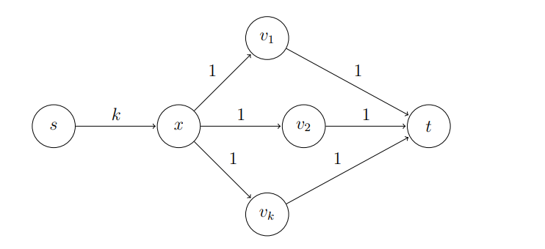
Goal & Motivation
Find a maximal flow over a directed graph
Source and sink vertices are given
Ford Fulkerson vs Push Relabel on the below network

Slide 3
Basic Definitions
A flow network ➔ G = (V,E) a directed graph
Two vertices {s, t} the source and the sink
Each edge (u,v) ∈E has some positive capacity c(u,v), if (u,v) ∉E c(u,v) =0.
The flow function f maps a value for each edge where:
  f(u,v) ≤ c(u,v)
  f(v,u) = - f(u,v) ( anti symmetry )
Saturated edge (u,v) ⬄ c(u,v) = f(u,v)

Slide 4
Basic definitions, contd.
r(u, v) = c(u,v) – f(u,v)
Residual graph R(V, E`) where E` is all the edges (u,v) where r(u,v) ≥0
Augmenting path p is a path from to the source to the sink over the residual graph
Important Result already Proved in Class
f is a maxflow ⬄ there is no augmenting path

Slide 5
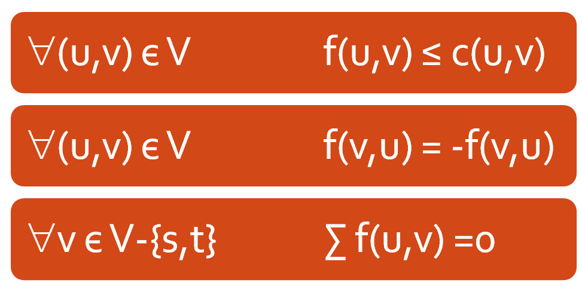
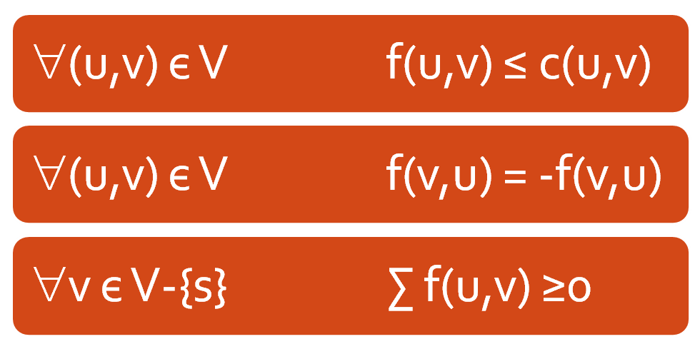
Preflow
Flow constrains:
Every vertex v may keep some “excess” flow e(v) inside the vertex

Slide 6
Excess handling
We strive to push this excess toward the sink
How do we push this excess flow (Push(v)) & types of push
If the sink is not reachable on the residual network the algorithm pushes the excess toward the source
When no vertices with e(v) >0 are left the algorithm halts, and the resulting flow (!) is the max –flow

Slide 7
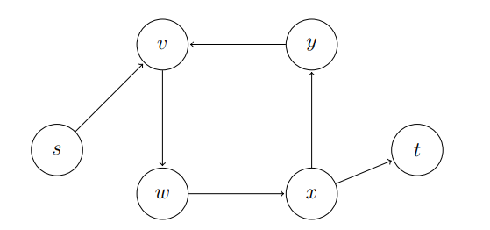
Limitations of Push & Solution
Just pushing flow around the residual network is not enough to obtain a correct maximum flow algorithm.

Slide 8
Heights & Invariants
A mapping function h(v) → N + { ∞ }
h(s) = n, h(t) = 0
r(u,v) > 0 → h(u) ≤ h(v)+1
Lemma 1: If s-t flow f is compatible with labelling h, then f is maximum value

Slide 9
Active vertex
Active vertex:
  v є V-{s,t} is active if
    h(v) < ∞
    e(v) > 0

Slide 10
Basic operations
Applied on active vertices only
Push (u,v)
  Requires: r(u,v) >0, h(u)=h(v)+1
  Action:
    δ = min( e(v) , r(u,v) )
    f(u,v) += δ, f(v,u) -= δ
    e(u) -= δ , e(v) += δ

Slide 11
Basic operations , contd.
Relabel (u)
  Requires: ∀(u,v) є V r(u,v) >0 → h(u) ≤ h(v)
  Action:
    h(u) = h(u)+1 or min { h(v) +1 | r(u,v) >0 } (Both relabel operations are correct, anyone of them can be used)
One of the basic operations is applicable on a active vertex:
  PUSH: Any residual edge (u,v) with h(u) = h(v) +1
  Otherwise: h(u) ≤ h(v) for all residual edges, allows relabel

Slide 12
The algorithm
Initialize: h(s) = n, v є V-{s} h(v) =0
Saturate the outgoing edges of s
While there are active vertices apply one of the basic actions on the vertex
Simple, isn’t it?
Let’s see an example

Slide 13
Example
- Saturate all source edges
4
4
0
2
2
2
S
0
T
2
2
4
1
0
0

Slide 14
Example – contd.
4,4
4
2
2
2
S
2
T
2,2
4
1
0
0
4
0
2
2
2
6
0
0
2
4
1
0
0
Relabel

Slide 15
Example – contd.
4,4
4
2
2
2
S
2
T
2,2
4
1
0
0
4
0
2
2
2
6
1
0
2
4
1
0
0
Push

Slide 16
Example – contd.
4,4
6
2
2,2
2
S
0
T
2,2
4
1
0
0
Relabel
4
0
2
2
2
6
1
0
2
4
1
0
0

Slide 17
Example – contd.
4,4
6
2
2,2
2
S
0
T
2,2
4
1
0
0
Push (twice)
4
1
2
2
2
6
1
0
2
4
1
0
0

Slide 18
Example – contd.
4,4
2
2,2
2,2
2,2
S
0
T
2,2
4
1
0
2
4
1
2
2
2
6
1
0
2
4
1
0
Relabel
0

Slide 19
Example – contd.
4,4
2
2,2
2,2
2,2
S
0
T
2,2
4
1
0
2
Push
4
2
2
2
2
6
1
0
2
4
1
0
1

Slide 20
Example – contd.
4,4
0
2,2
0,2
2,2
S
2
T
2,2
4
1
0
2
4
2
2
2
2
6
1
0
2
4
1
0
1
Relabel, Push

Slide 21
Example – contd.
4,4
2
2,2
2,2
2,2
S
0
T
2,2
4
1
0
2
Relabel, Push
4
2
2
2
2
6
3
0
2
4
1
0
1

Slide 22
Example – contd.
4,4
0
2,2
0,2
2,2
S
2
T
2,2
4
1
0
2
4
4
2
2
2
6
3
0
2
4
1
0
1
Relabel, Push

Slide 23
Example – contd.
4,4
2
2,2
2,2
2,2
S
0
T
2,2
4
1
0
2
Relabel, Push
4
4
2
2
2
6
5
0
2
4
1
0
1

Slide 24
Example – contd.
4,4
0
2,2
0,2
2,2
S
2
T
2,2
4
1
0
2
4
6
2
2
2
6
5
0
2
4
1
0
1
Relabel, Push

Slide 25
Example – contd.
4,4
2
2,2
2,2
2,2
S
0
T
2,2
4
1
0
2
Relabel, Push
4
6
2
2
2
6
7
0
2
4
1
0
1

Slide 26
Example – contd.
2,4
0
2,2
2,2
2,2
S
0
T
2,2
4
1
0
2
2,2
7
2
2
2
6
7
0
2
4
1
Push
0
1

Slide 27
Example – contd.
2,4
0
2,2
2,2
2,2
S
0
T
2,2
2,4
1
2
0
2,2
7
2
2
2
6
7
0
2
2,2
1
0
Relabel
1

Slide 28
Example – contd.
2,4
0
2,2
2,2
2,2
S
0
T
2,2
2,4
1
2
0
2,2
7
2
2
2
6
7
0
2
2,2
1
1
Push
1

Slide 29
Example – contd.
2,4
0
2,2
2,2
2,2
S
0
T
2,2
2,4
1,1
1
0
2,2
7
2
2
2
6
7
0
2
2,2
1
1
Relabel, Push
1

Slide 30
Example – contd.
2,4
0
2,2
2,2
2,2
S
0
T
2,2
1,4
1,1
0
1
2,2
7
2
2
2
6
7
0
2
3,1
1
2
Relabel, Push
1

Slide 31
Example – contd.
2,4
0
2,2
2,2
2,2
S
0
T
2,2
2,4
1,1
1
0
2,2
7
2
2
2
6
7
0
2
2,2
1
2
Relabel, Push
3

Slide 32
Example – contd.
2,4
0
2,2
2,2
2,2
S
0
T
2,2
1,4
1,1
0
1
2,2
7
2
2
2
6
7
0
2
3,1
1
4
Relabel, Push
3

Slide 33
Example – contd.
2,4
0
2,2
2,2
2,2
S
0
T
2,2
2,4
1,1
1
0
2,2
7
2
2
2
6
7
0
2
2,2
1
4
Relabel, Push
5

Slide 34
Example – contd.
2,4
0
2,2
2,2
2,2
S
0
T
2,2
1,4
1,1
0
1
2,2
7
2
2
2
6
7
0
2
3,1
1
6
Relabel, Push
5

Slide 35
Example – contd.
2,4
0
2,2
2,2
2,2
S
0
T
2,2
2,4
1,1
1
0
2,2
7
2
2
2
6
7
0
2
2,2
1
6
Relabel, Push
7

Slide 36
Example – contd.
2,4
0
2,2
2,2
2,2
S
0
T
2,2
1,4
1,1
0
1
2,2
7
2
2
2
6
7
0
2
3,1
1
8
Relabel, Push
7

Slide 37
Example – contd.
2,4
1
2,2
2,2
1,2
S
0
T
2,2
1,4
1,1
0
0
Push
2,2
7
2
2
1,1
6
7
0
2
3,1
1
8
8

Slide 38
Example – contd.
1,4
0
2,2
2,2
1,2
S
0
T
2,2
1,4
1,1
0
0
3,1
7
2
2
1,1
6
7
0
2
3,1
1
8
8

Slide 39
Complexity Analysis
Key Lemma: Let f be a preflow. If the node v has excess, there is a path in Gf (residual graph) from v to the source s
  A is set of all vertices that have a path till the s in residual graph
  There exist no edge e = ( x, y) leaving A with positive flow value
  All the nodes with positive excess is in A.

Slide 40
Bound on Height of Vertex:
Claim: h(v) ≤ 2*n – 1
From previous key lemma, there exist a path from v to s in residual graph.
Using the fact that along the path height decreases by at most 1 (steepness constraint)
Thus, h is finite for any v during the run of the algorithm

Slide 41
Bound on number of Relabels
Claim: Throughout the algorithm, each node is relabeled at most 2n-1 times, and total number of relabeling operations is O(n²)

Slide 42
Bound on number of Push
Amount of push is bounded by the excess on a vertex and residual capacity in the residual Graph.
Saturating Pushes: capacity of the edge is bottleneck
Non-Saturating Pushes: excess on the vertex is bottleneck

Slide 43
Bound on number of Saturating Push
Claim: Throughout the algorithm, the number of saturating push operations is at most O(nm)
Observation: Between two saturating pushes of the edge e = ( v, w ), each vertex {v,w} is relabelled atleast twice.
Label of vertex can increase by 2 atmost n-1 times, hence saturating pushes can occur at most n times.
There are m edges, hence bound O(nm)

Slide 44
Bound on Non-Saturating Pushes
Claim: Throughout the algorithm, the number of non-saturating push operations is at most O(mn²)
Potential: Φ = ∑h(v), for v with positive excess
  Φ is Zero in the beginning and in the end
A saturating push increases Φ by ≤ 2n-1
  All saturating pushes worth O(mn²)
A relabeling increases Φ by exactly 1
  All relabeling worth O(n²)
A Non-Saturating push decreases Φ by at least 1
Thus, there are up to O(mn²), Non-Saturating push

Slide 45
Complexity analysis
Any reasonable sequential implementation will provide us a polynomial algorithm
  How much a relabel operation cost? O(n²)
  How much a push operation cost? O(n²m)
  How much cost to hold the active vertices? O(1)

Slide 46
Implementation
For an edge in {e = (u,v) | (u,v) єE or (v,u) єE } hold a struct of 3 values:
  c(u,v) & c(v,u)
  f(u,v)
For a vertex v єV we hold a list of all incident edges in some fixed order
  Each edge appears in two lists.
We also hold an “current edge” pointer for each vertex

Slide 47
Implementation – contd.
Admissible arc in the residual graph
h(u) = h(v) + 1
u
Current edge
Push/relabel operation:
  If the current edge is admissible perform push on the current edge and return
  If the current edge is the last one, relabel the node and set the current edge to the first one in the list
  Otherwise, just advance the current edge to the next one in line

Slide 48
Is this correct?
When we relabel a node we’ll have no admissible edges:
  Any of the other edges (u,v) wasn’t admissible before and d(v) can only grow
  If it had r(u,v) =0 before and now it is positive we had h(u) = h(v) + 1, and so h(v) < h(u)
Hold a list of all active nodes – O(1) extra cost per push/relabel operation

Slide 49
And it costs
Number of relabelings – 2n-1 per vertex
Each relabeling causes a pass over all the edges of the vertex – m for all the vertices
Besides that we have o(1) per push performed (recall O(mn²) non saturating pushes).
Total – O(mn + mn²) = O(n²m)

Slide 50
Chose the Vertex with maximum Height
Claim 5: If at each step we choose the node with excess at maximum height, then the number of non saturating push operations is at most 4n³ down from 2mn²
Theorem: Push Relabel runs in O(n³) time

Slide 51
Code Demonstration and Interesting Results

Slide 52
Questions?
Thank you for listening

